Slide 2









不远处传来了卡罗尔和朱莉的欢笑声，她们似乎意外地发现了一些奇异的贝壳，而在我脚下，潮水不断地拍打着岩石. ...
我低下头，目不转睛地盯着那张纸。
慢慢地，我感到微风轻拂着我的脸，梳理着我的头发，帮助我理清了思绪。
In the near distance came the joyful laughter of Carol and Julie, seemingly having found some extraordinary shells out of their expectation, and at my foot, the waves of tide kept touching the rock periodically. ...
I lowered down my head and glued/gluing my eyes to the rest of the paper.
Slowly, I felt the gentle breeze on my face, combing through my hair, which helped clear my thought.
.

Slide 3
我紧紧抓着那张纸，在他那仍然阴沉的脸上寻找答案。
父亲首先打破了沉默。
我迅速打断了他的话
父亲被我的回答吓了一跳，惊讶地问道
我笑了笑他的突然反应:“我发现在我的心里有一个安静的灵魂，他更喜欢广阔而深沉的海洋作为朋友。”
I searched for an answer on his still gloomy face, while holding the paper tightly.
Father broke the silence first.
I briskly cut his words by replying
Startled by my answer, father asked in astonishment
I chuckled at his abrupt reaction “I found at my heart rests a quiet soul who prefers the vast and deep ocean to be a friend.”

Slide 4
猫摇着尾巴很快出现在我们的视线里，神气十足地在院子里小跑着。
那天晚上，我们发现一只可爱的黄猫在我们的树林里跳来跳去，寻找老鼠。
土拨鼠不见了。
夕阳把天空染成了粉红色、紫色和金色。我禁不住心满意足地叹了口气。
Cheryl's猫在远处喵喵叫。
Waving his tail, the cat came into our sight shortly, trotting lordly(proudly) down the yard.
That evening, we spotted the sweet yellow cat springing around in our woods in search of mice.
The groundhogs were nowhere in sight.
The sunset painted the sky pink, purple and gold. I couldn' t help sighing contentedly.
Cheryl's cat meowed in the distance.

Slide 5
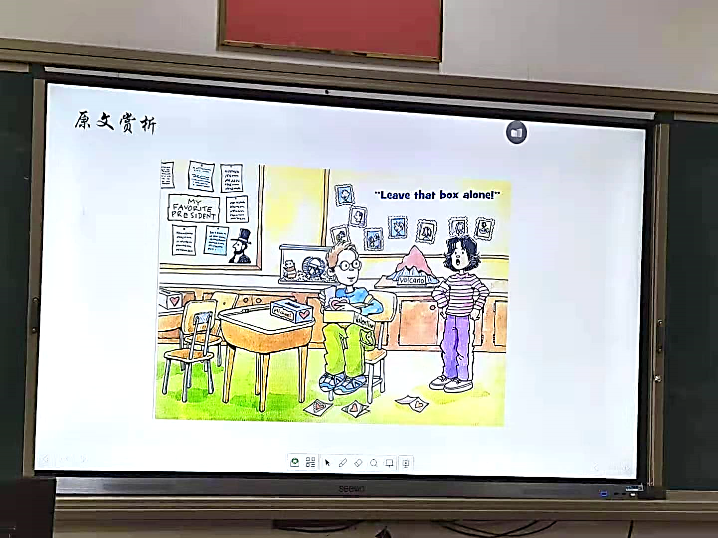

A Valentine’s trick

Slide 6

本次续写主要问题
缺乏主题意识（（Peterson wasn’t as bad a boy as I thought of;)主题没有得到很好地传达
没有按照主题有效设计情节；情节发展逻辑性不够严密，或与原文情节融洽度不高；与段首句的协同不够（what I heard)；
文化差异
不了解Valentine’s Day 的真正含义;没有注意到中外名字的表达差异given/first name + family name（Michael Peterson; Michael Rogers) ；没有了解国外break 期间教室一般没人；

Slide 7

Valentine's Day
Valentine's Day is a special day of love!
It is a day to celebrate friendship and love.
It is a time to give little gifts to special people
It is a day to make handmade valentine cards for your family and friends.
It is a time to share a story and a smile with
someone you like.

Slide 8

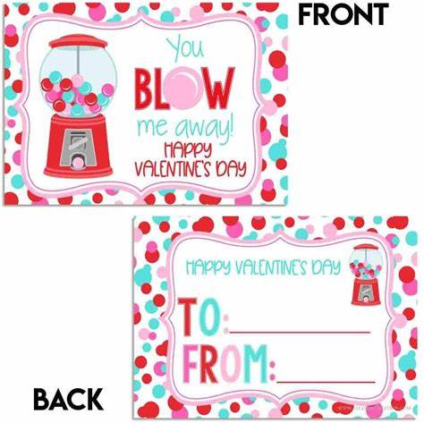
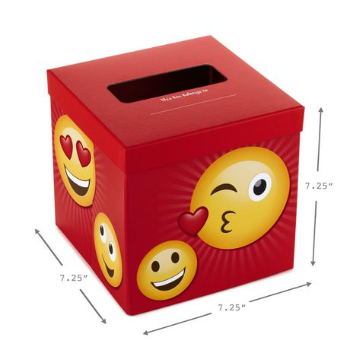
输入您的文字内容
输入您的文字内容
Effects on others
Thoughts
输入您的文字内容
Michael
Josh

Slide 9

从所给段首句找续写点并设计有效情节（3 scenes)
动作描写
心理描写
适当的有效对话
Para 1. The more I watched my next-door neighbor,
the more confused I became.
What did I watch?
Why did “I” become more confused?
What would he explain?
“I” refused to help him first.
He explained something to me.
Para 2. I stood there, not quite believing what I was hearing.
How did “I” feel after I heard his explanation?
What did “we” do together?
Lesson gained

Slide 10
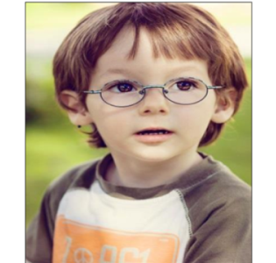
从所给段首句找续写点并设计有效情节:
sure, worried
careful/
eager
Para 1. The more I watched my next-door neighbor,
the more confused I became.
hurried, anxious
What did I watch?
Why did “I” become more confused?
What would he explain?
对应：He didn’t play tricks but……
对应：He seemed to do something good.
annoyed,
worried
对应：He wanted to send love cards.
Para 2. I stood there, not quite believing what I was hearing.
amazed
confused;
How did “I” feel after I heard his explanation?
What did “we” do together and how did I feel?
hopeful/delighted
Embarrassed
对应：I was moved and helped him make cards together.
embarrassed
satisfied/hopeful
I cleared the misunderstanding--- Michael Peterson was not a bad but a nice boy.

Slide 11
他忙于在卡片盒里翻找，汗水从脸上滴下来。
2. “快来帮我”，他催促道。
3. 我眨了眨眼，但不回答。
4. 我皱了皱眉,冷冷地指责他不该捉弄新同学。
5. 他拼命向我解释。
Sweat trickled down his face as he dug in the card boxes.
“Come and help me, "he urged.
I blinked but gave no reply.
I frowned and scolded him coldly for playing tricks on the new student.
He tried hard /desperatelyto explain to me .

Slide 12
听了他真诚的解释，我尴尬地甚至歉意地笑了笑。
我的脸上掠过一阵尴尬的红晕。
我感到很尴尬，低下头.羞愧使我顿时哑口无言。
我感到一种既尴尬又满足的混合心情涌上心头。
我搔着头，歉意地喃喃自语。
Hearing his sincere explanation I smiled in an awkward, almost apologetic, way.
A flush of embarrassment swept across my face.
Embarrassed, I dropped my head. Shame suddenly silenced me
I felt a mixture of embarrassment and satisfaction striking into my heart.
I scratched my head，mumbling apologetically.

Slide 13
6. 我从来没想到他会做好事。
7. 发现果然是上面写着”Michael”的爱心卡片，我瞪大眼睛呆立在哪里。
8.我羞得满脸通红，想偷偷溜出去而不被人发现。
Never did it occur to me that he could do anything good.
Having realized it was a love card that said "Michael" on it, I froze/ rooted there with my eyes widened.
I flushed with shame and tried to sneak out without being seen.

Slide 14
I helped Michael to shake out his cards through the slot(狭槽） in his valentine box.
Then we stuffed the cards into Michael Rogers’ box.
Confusion had faded away. Instead happiness occupied/enveloped the corner of the classroom.

Slide 15
手里拿着制作精美的卡片，他兴奋地尖叫起来。
读着卡片上的字，他笑了。
我们交换了满意的眼神，沉浸在幸福之中。
我们躲在门后，激动得浑身发抖。
With the well-drawn cards in hand, he screamed with excitement.
Reading the words on the cards, he grinned/beamed with joy.
When he read the best wishes on the cards, excitememnt
was dancing in his eyes.
We exchanged satisfied eyes, immersed in happiness.
We hid behind the door, trembling with excitement.

Slide 16
About the language and writing style
尽可能用精彩的名词、
动词、形容词和副词等实词；
巧用小词，如介词；
虚词越少越好
How to improve your language
How to make your writing style consistent with the original
一是把握理解语言风格
在读后续写中传达原文风格
在续写中，关键看语言，语言的准确和得体最重要！

Slide 17
Para.1
The more I watched my next-door neighbor, the more confused I became. I had no idea about what Michael Peterson was doing but thinking of the trick he once played on me. Suddenly, a wave of anger flooded into my whole body. I felt my blood boiling. I strode towards Michael Roger’s desk, firmly determined to stop his evil behaviors. But what I saw next thoroughly surprised me. He was putting some cards carefully into Roger’s box. “As a new kid, he might have been forgotten by our classmates. I just sent him some cards I received. After all, all they were sent to Michael.” he tried to explained , ‘‘Now I’m going to make some new cards for him. Would you like to join me?’’
Para.2
I stood there, not quite believing what I was hearing. With my jaw drooping, I almost popped my eyes out of my head. Rooted in the ground, I felt my face flush. How silly was I for having thought Peterson was stealing valentine cards from Roger’s box! To make up for my mistake, I decided to help Peter make new cards. Peterson was delighted for my participation. For the following moment, we cooperated with each other with great enjoyment. I drew vivid pictures to decorate the cards while my next-door neighbor added some best wishes on them. At the very last second before the bell rang for the next class, we two grabbed hold of all the cards we made, placing them into Roger’s box with satisfaction. What a relief! A big surprise was there, waiting for our new classmate, Michael Roger. Not until then did I recognize a brand-new Michael Peterson!
照应前文Peterson人物形象
延续前文angry情绪
照应前文stop his trick情节
照应my feeling 转折及说明关键词watch内容
照应前文a new kid & had forgotten & two Michael情节并将解释将“恶作剧”真相浮出水面。承上启下
照应并再次铺垫前文help情节
延续情绪线embarrassed/ashamed
照应并完成help情节构建
照应主题love/kindness 反转人物形象

Slide 18
The more I watched my next-door neighbor, the more confused I became.Instead of taking valentines out of the box, he was putting them in. But whatever he did, I was sure it was wrong. I scolded him for picking on the poor kid. Michael just kept working and denied playing a trick. He explained that he was the last person to pass out his valentines before break. When he got to Michael Rogers’ box, he noticed it was empty. No one remembered to make the new kid a card. So actually he was giving him his cards. After all, the cards he received from classmates all said “Michael “ on them.
I stood there, not quite believing what I was hearing. “ You mean you’re doing something nice?” I asked. “Of course. When haven’t I been nice?” he teased. I blinked but gave no reply. I helped Michael to shake out his cards through the slot in his valentine box.Then we stuffed the cards into Michael Rogers’ box. I felt a mixture of embarrassment ad satisfaction striking into my heart. Maybe I had misunderstood him and maybe he’s even kind of sweet... in a hidden sort of way.

Slide 19
languange

Slide 20
Learn topic vocabulary：school life
翻译：
别费心去做了
跟踪
试图忽略某人
开……的玩笑
坐在我旁边
策划/谋划
在操场上休息
从单杠上荡下来
Don’t bother to do
Keep track of
try to ignore sb.
play a trick on
sit next to me
be up to something
on the playground for break
swing down from the monkey bars
课间休息结束了，同学们从操场上一个接一个有说有笑地回来。
Break was now over and my classmates came back from the playground one after another, talking and laughing.

Slide 21
Pay attention to the linguistic style
simple, precise,
vivid. varied, pictorial
vivid verbs and adj.,adv. &prep. phrase
荡下去
耸肩
咧开嘴笑
叹气
前往
命令
凝视，盯住
补充说
swing down
shrug
糟糕的
滑稽的
令人困惑的
极度愤怒地
惊讶地
terrible
grin
funny
sigh
confusing
head for
extremely angry
order
in amazement
stare at
add
如：我耸了耸肩，盯着他，不相信地问：“你送爱心卡给他？”
I shrugged, stared at him, and asked in disbelief, "You are making him a love card?”

Slide 22
Learn from the varied sentence structures
正常情况我不会费心跟迈克尔·彼得森联系。（adv.）
2. 我今天决不会让他耍卑鄙的花招。（倒装句）
3.上周，他在我背上放了个牌子，上面写着:“给我唱歌吧!”(定从)
4.无论我走到哪里，我甚至不认识的人都开始对我唱歌。
Normally， I didn’t bother to keep track of Michael Peterson.
No way was I going to let him play a mean trick today.
Last week, he put a sign on my back that said Sing to Me!
Everywhere I went, people I didn’t even know started singing to me.

Slide 23
Learn from the varied sentence structures
5. 迈克尔·彼得森在那儿——在迈克尔·罗杰斯的办公桌前，在他那盒情人节卡片里挖呀挖呀!”（用非谓语）
6. 我越观察隔壁的邻居，就越感到困惑。
7. 我站在那里，不太相信我所听到的。
There was Michael Peterson--at Michael Rogers' desk, digging in his box of valentine cards!
The more I watched my next-door neighbor, the more confused I became.
I stood there, not quite believing what I was hearing

Slide 24

How to write
Para 1. The more I watched my next-door neighbor,
the more confused I became.
How to describe Peterson’s behavior?
How did he explain?
How to describe my feeling?
was buried in/focused on…digging in the box
Sweat dripped from one's face;
Sweat trickled down his forehead...
murmured; urged; pointed ; turned over
explained to me desperately; apologized;
drew; made; exchanged
Michael
Peterson
Para.1
amazed
confused;
frowned， blinked, my expression hardened
stared at him angrily in disbelief
warned him; tried to drive him away
rooted there with my eyes widened
“I”

Slide 25
He explained about his behavior
He explained that he was trying to put valentine cards into Rogers' box.
Magically, he took out a few cards from his pocket and stuffed/pressed/squeezed them into the box.
“Yes, it is truly a trick, but I’ve played it out of kindness,” he teased.
This morning he noticed that nobody remembered to prepare cards for Rogers. So he intended to give Rogers his cards. After all, the cards said to Michael on them.
Coincidentally, Rogers’ given name was Michael. So he would consider that the cards in his box were specially ready for him.

Slide 26
Embarrassment enveloped me totally.
A flush of relief swept over me.
What I was trying to stop turned out to be an act of kindness.
It was Michael Peterson who remembered to bring happiness to Michael Rogers, a new comer who had been ignored on this special day.
After making a sincere apology to him, I helped him carry out the great task.
I was moved by Peterson's hidden kindness.
I could imagine that no sooner had Rogers opened his box than a brilliant smile spread across his face.
Surely, he would fit into the lovely class smoothly.
That was the most meaningful Vatlentine's Day I had ever experienced.

